Slide 1
Capstone Project
On
Play Store App Review Analysis(EDA)
Project Contributor : Kuldip Parmar

Slide 2
● What Is EDA ? ● Overview Of Dataset(play store) ○ Descriptive statistics(Summary) ○ Data Cleaning ○ Data Visualization ● Understanding the dataset(user reviews) ○ Descriptive statistics(Summary) ○ Data cleaning ○ Data Visualization ● DataFrame Merging(play store & user review)
Table Of Content

Slide 3
What is Exploratory Data Analysis ?
Exploratory Data Analysis (EDA) is an approach to analyze the data using visual techniques. It is used to discover trends, patterns, or to check assumptions with the help of statistical summary and graphical representations.
Collect Data / Load Dataset
Understand the Data and Data Types
Get Statistical Summary
1
2
3
Visualize Insights
Make Data Ready For Visualization
Data Cleaning & Missing Value Filling
6
5
4

Slide 4
Problem Statement
How to know which Category’s or Genres’s App user preferred the most, that could leads the growth of Business or Organization or successive App launch for Developer or Company.
How to know the psychology of user preference or usage of App without Analysis of Data of that Area ?
How to know the key factors responsible for app engagement and success ?
How can someone Predict the App success ratio and user preferable App before launching the app by only seeing the raw data or just by seeing play store ?

Slide 5
Process of EDA
Understand Row & Column :
First step after collecting data or by using dataset is to understand Rows and Columns And their datatypes
As we know Data can be in structured form or unstructured also , so we need to change the datatypes.
If any numerical column is in string form we have to convert it into numeric.
Mostly analysis done on numerical values so have to keep in mind.

Slide 6
Handling Missing and Null values :
There is no clean data in dataset so we have to fill out missing values as per requirements or have to drop it.
To Fill a numeric value(e.g. 0) or string value(e.g. ‘Unknown’) at missing cell is not great deal.
We have to use statistical methods like mean, median, mode etc. to put the accurate or nearest values to get more accurate results.

Slide 7
Libraries Used
● NumPy ( Numerical Python )
● Pandas ( Data reading & Data cleaning )
● Matplotlib( Data Visualization )
● Seaborn ( Data Visualization )

Slide 8
Play Store Dataset
Column Overviews :
° Install column - total installed of application.
° Price column - price value is in dollar($).
° Reviews column - total reviews made by reviewer of application
° Size column - size of application which is in 'MB'
° Android_Ver column - compatible version of application for android device
° Current_Ver column - Latest version of application

Slide 9
° Genres column - Category and area of that application
° Content_Rating column - Age restriction for application installs
° Category column - main area of application
° Last_Update column - when last time application updated or review given
° Rating column - rating given by user to an application
° Type column - it describe wether application is free or paid
° App column - App contains name of application and what about the application

Slide 10
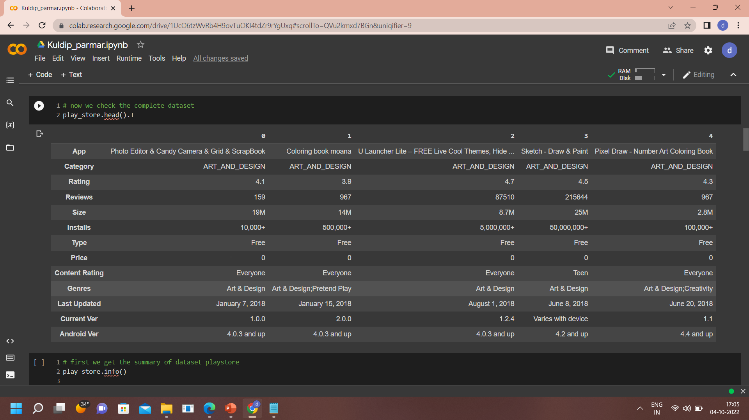
Data Exploration
First Look of Data

Slide 11
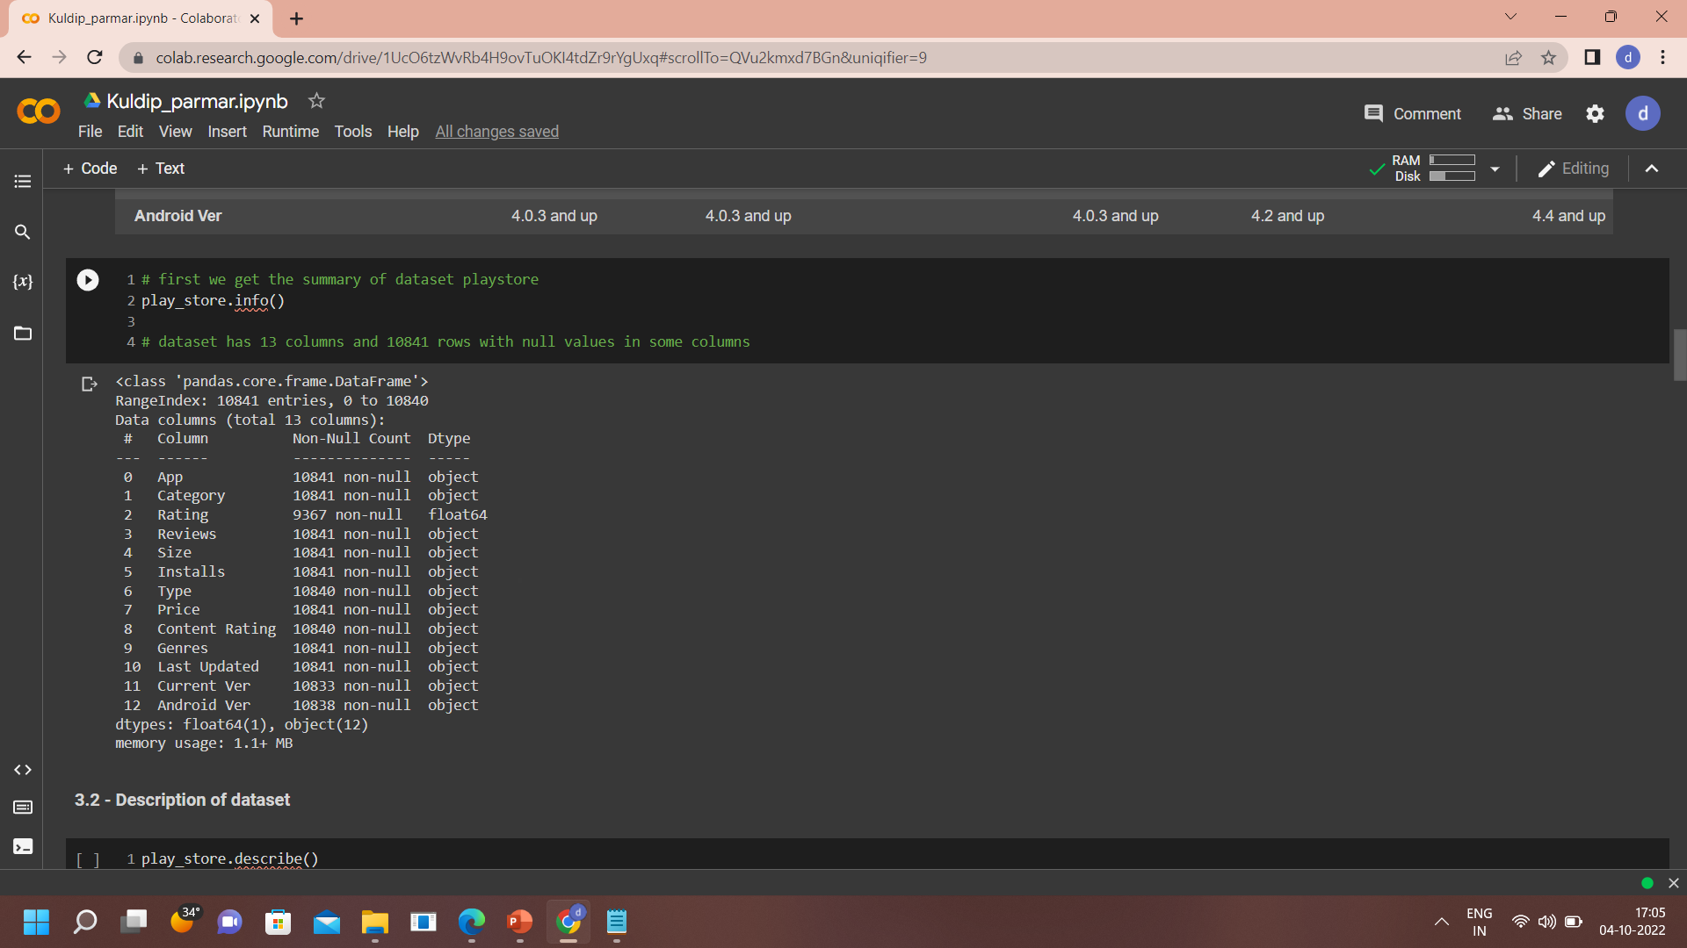
Overall Info

Slide 12
Categories of Column
Numerical Columns
Price
Size
Installs
Rating
Reviews
Android_Ver
Current_Ver
Categorical Columns
App
Category
Type
Genres
Content_Rating
Last_Updated

Slide 13
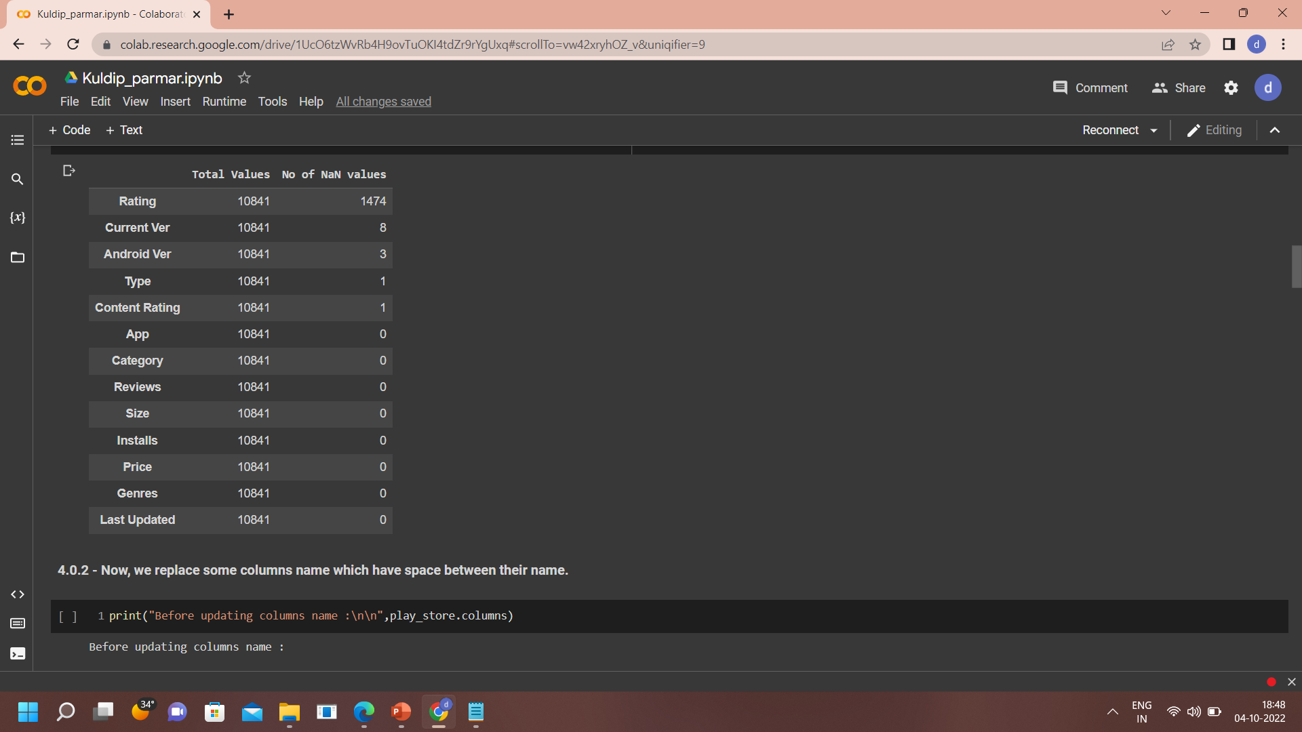
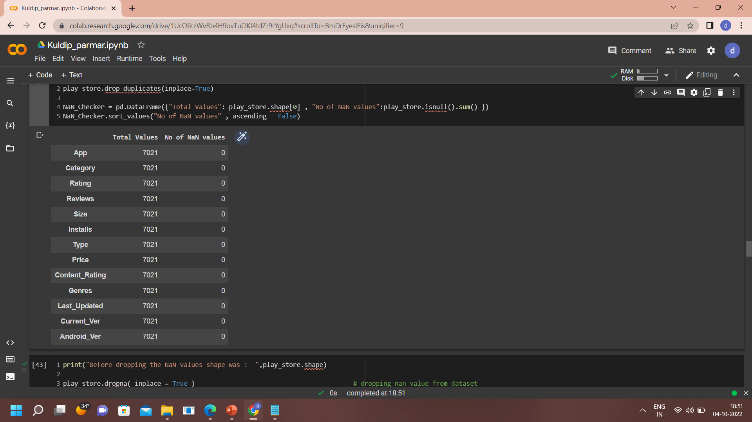
Data Cleaning
Nan Value Cleaning
Nan Values removed. also rows dropped from 10841 to 7021.
Before Cleaning
After Cleaning

Slide 14
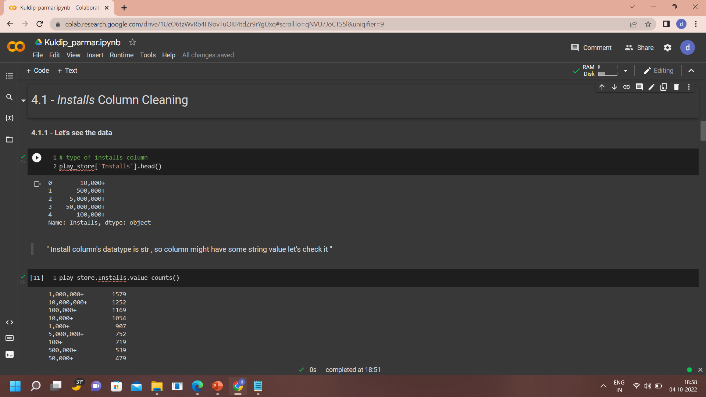
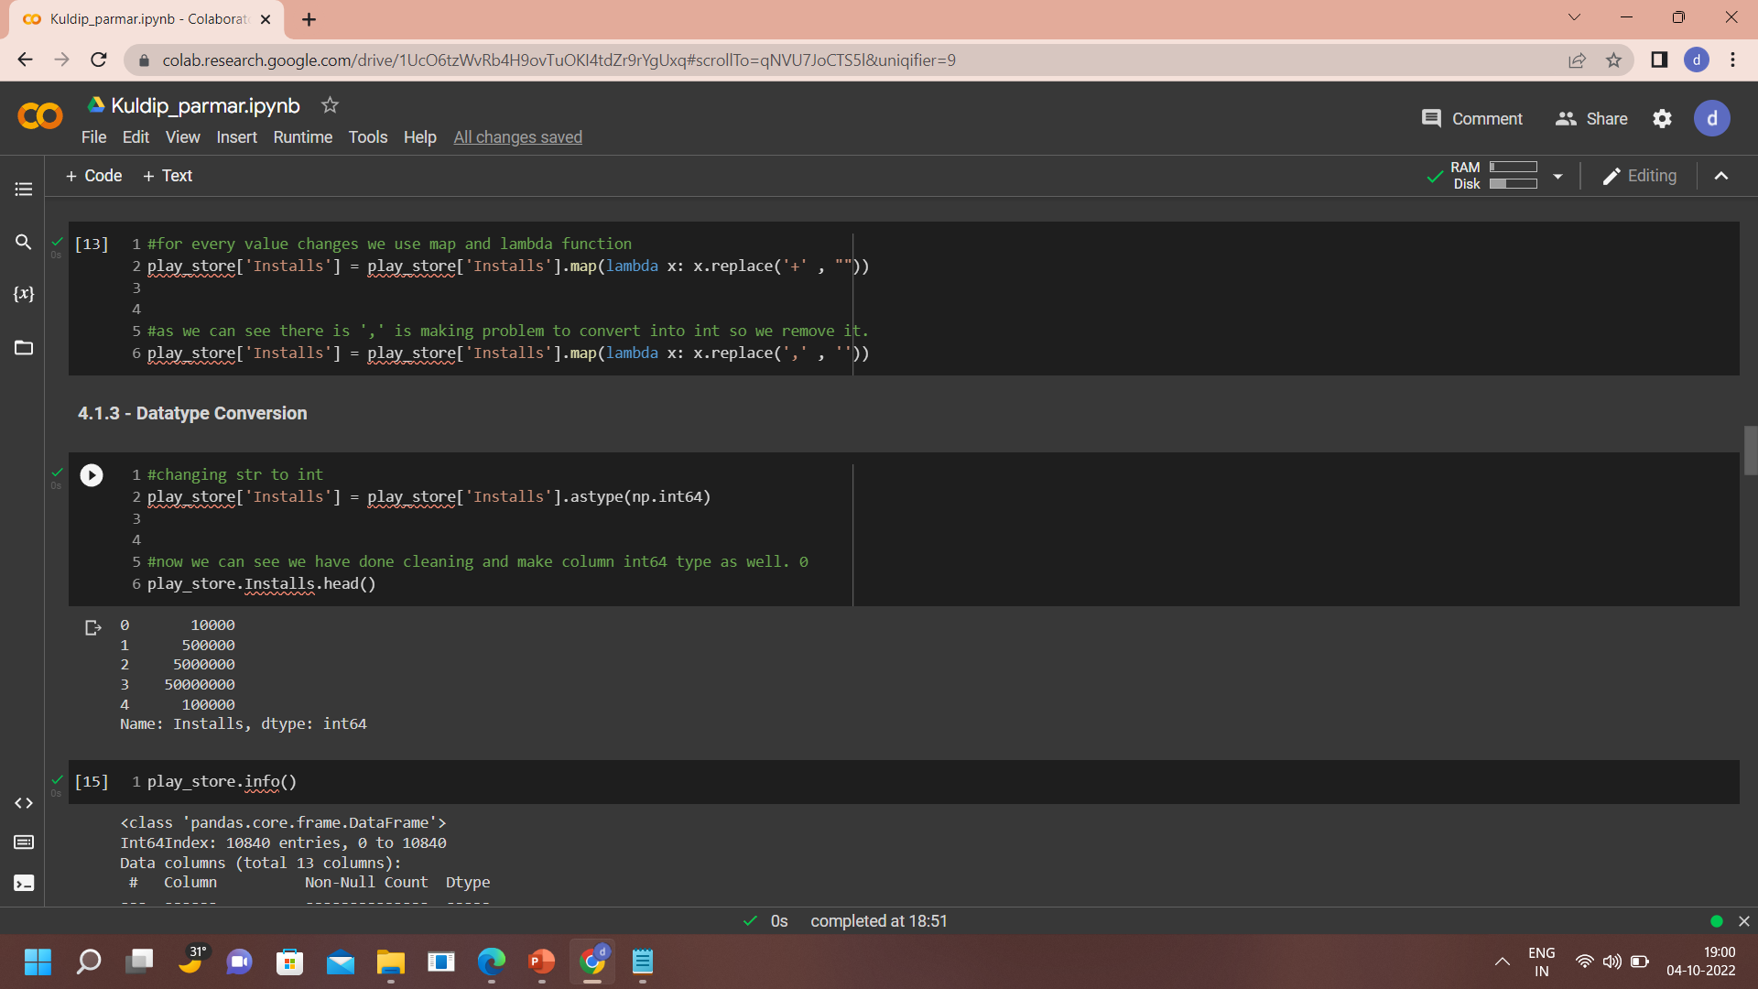
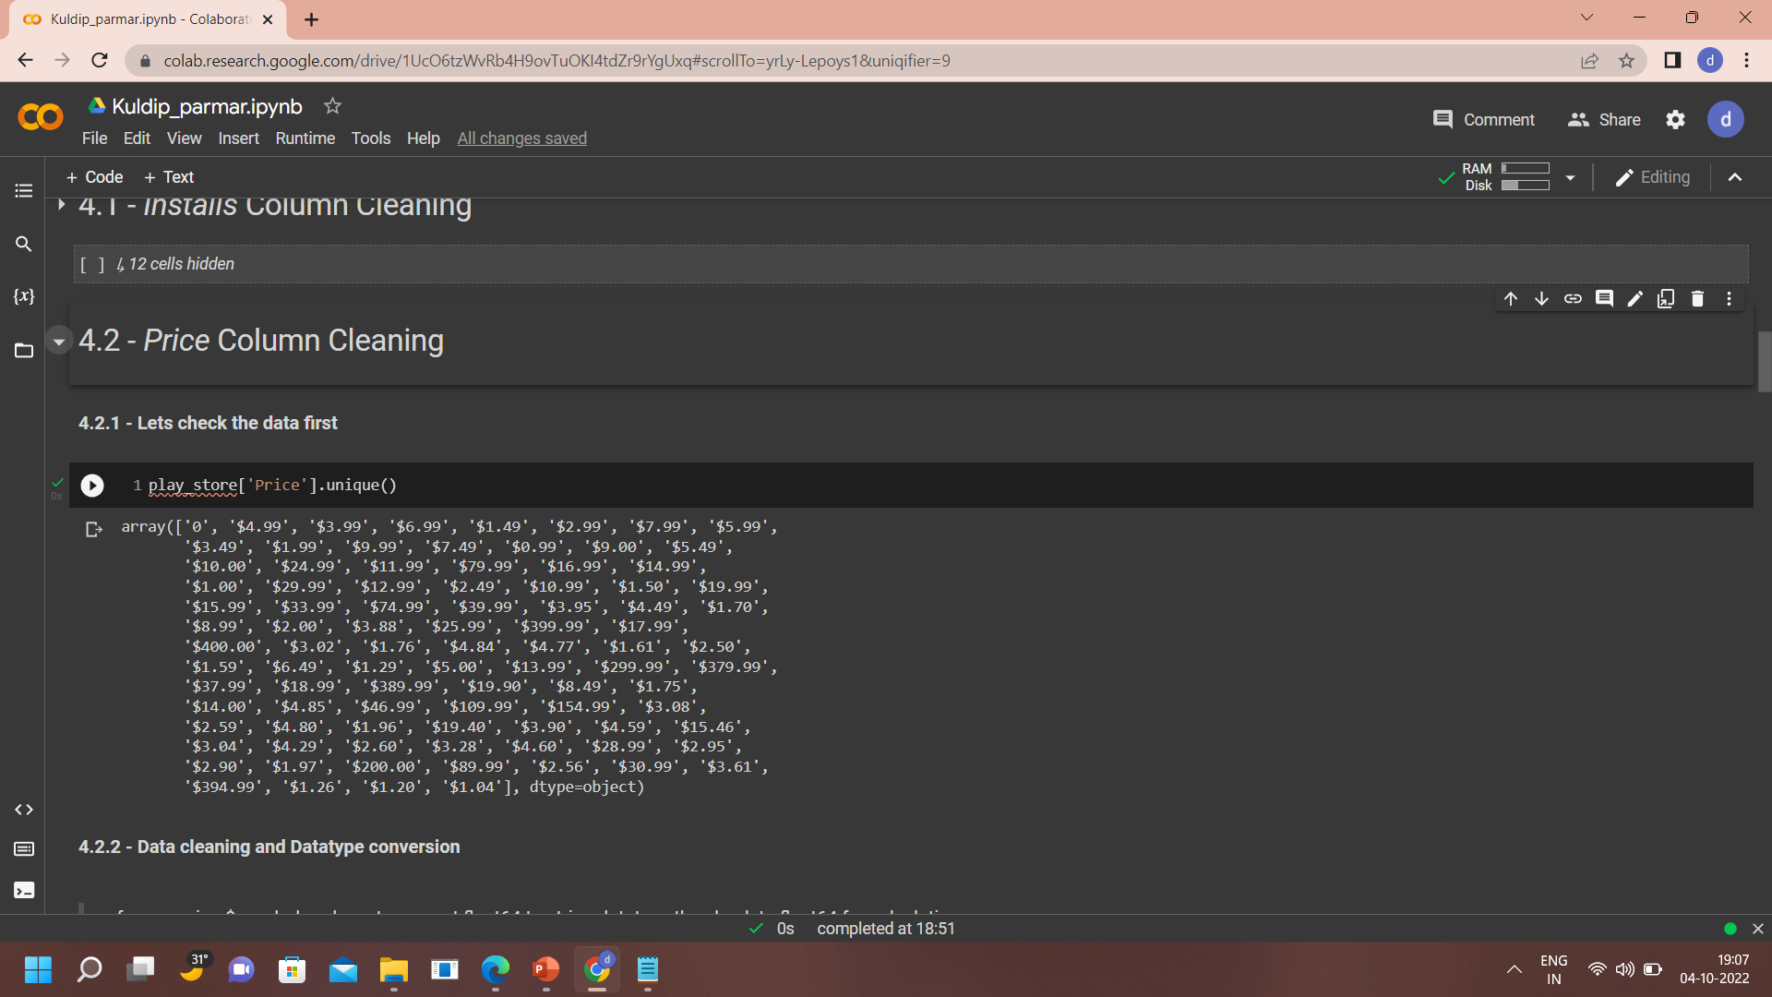
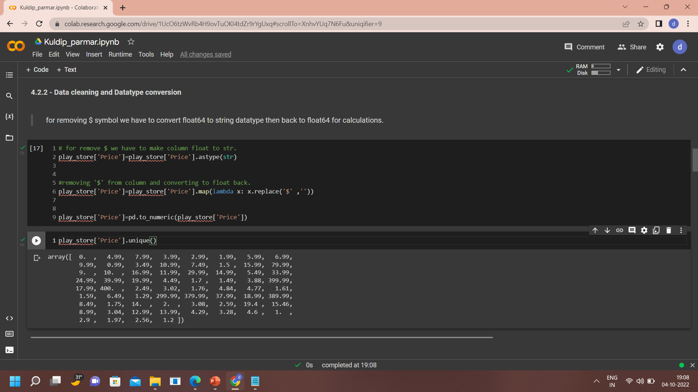
Install Column Cleaning
+ sign removed
Before Cleaning
After Cleaning
Price Column Cleaning
$ sign removed
Before Cleaning
After Cleaning

Slide 15
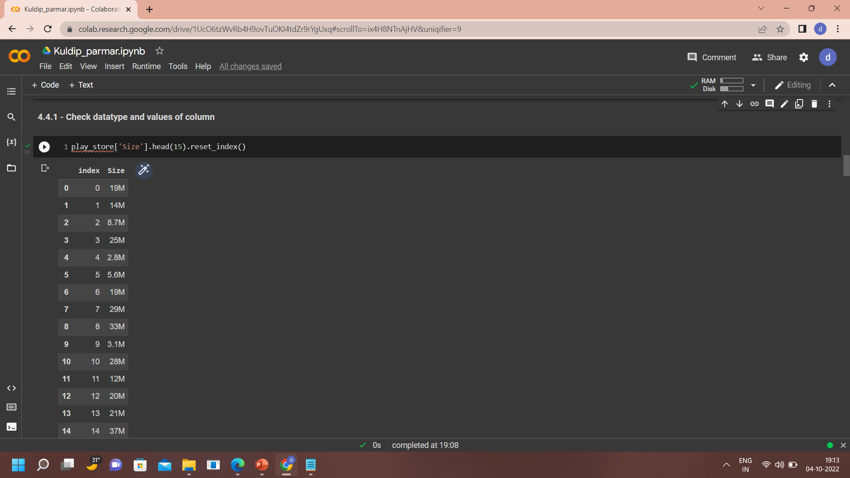
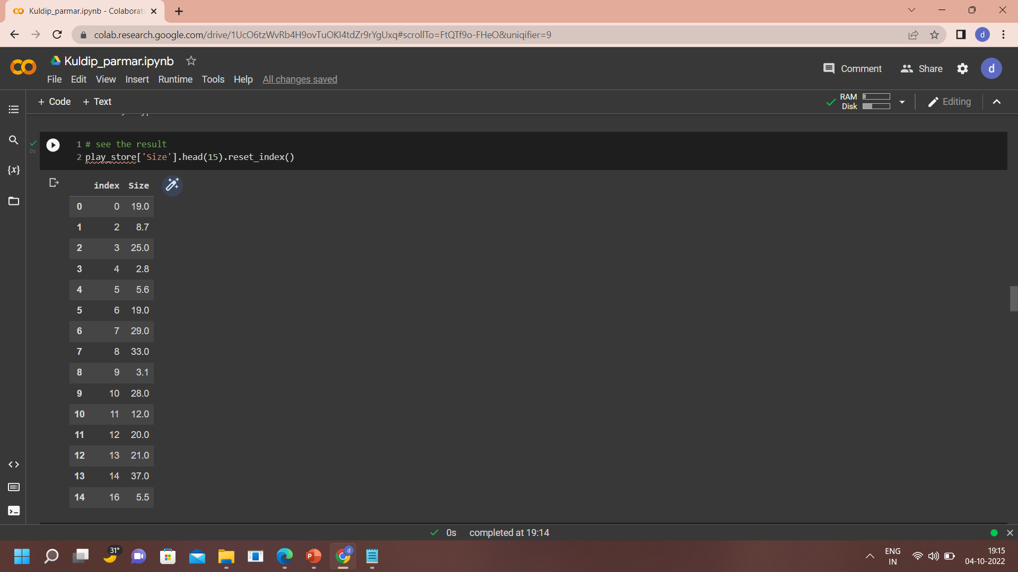
Size Column Cleaning
M removed
&
All size converted into MB.
Before Cleaning
After Cleaning

Slide 16
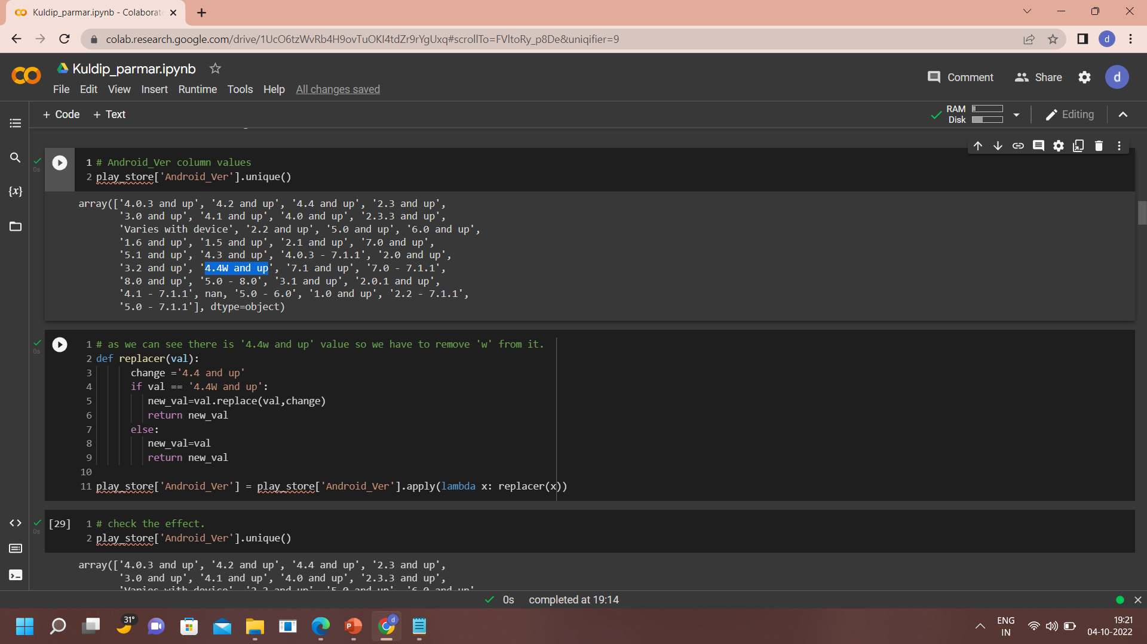
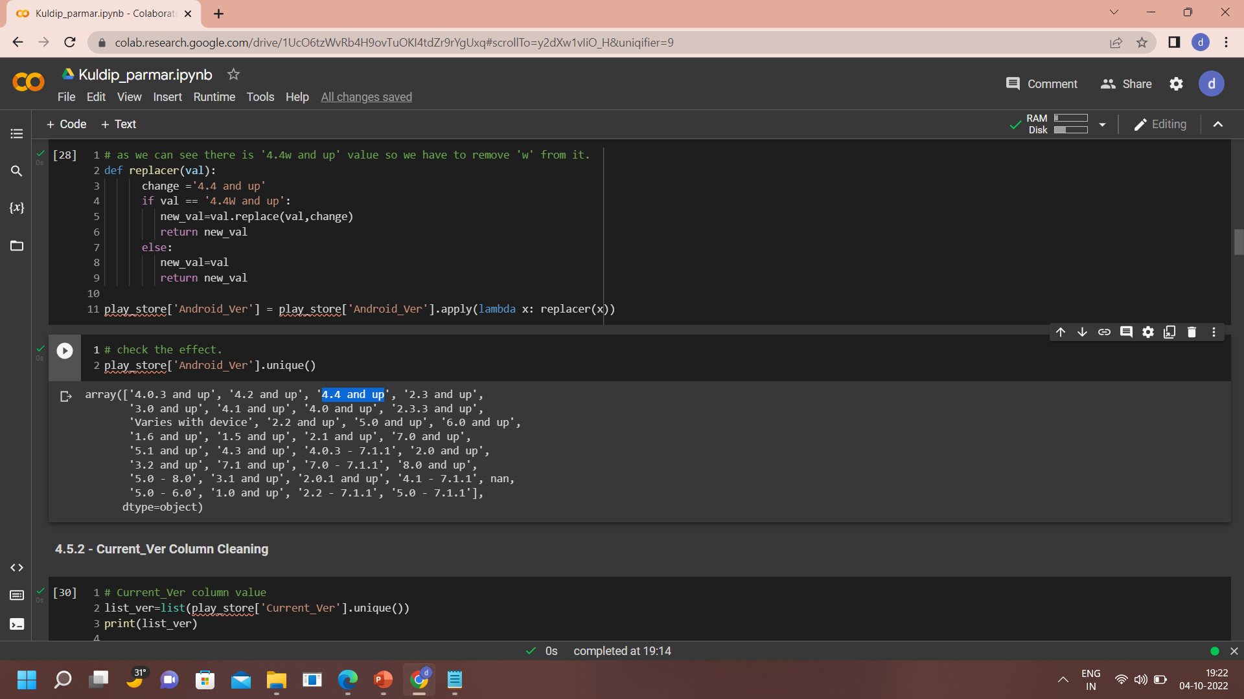
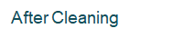
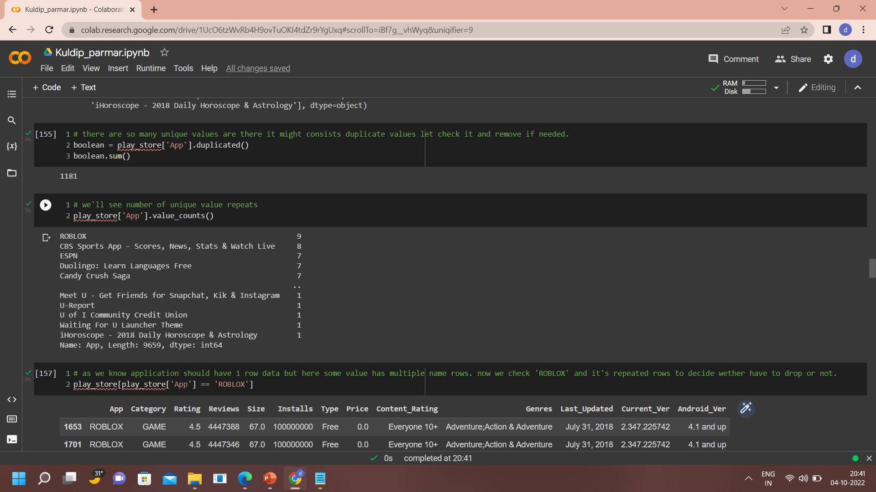
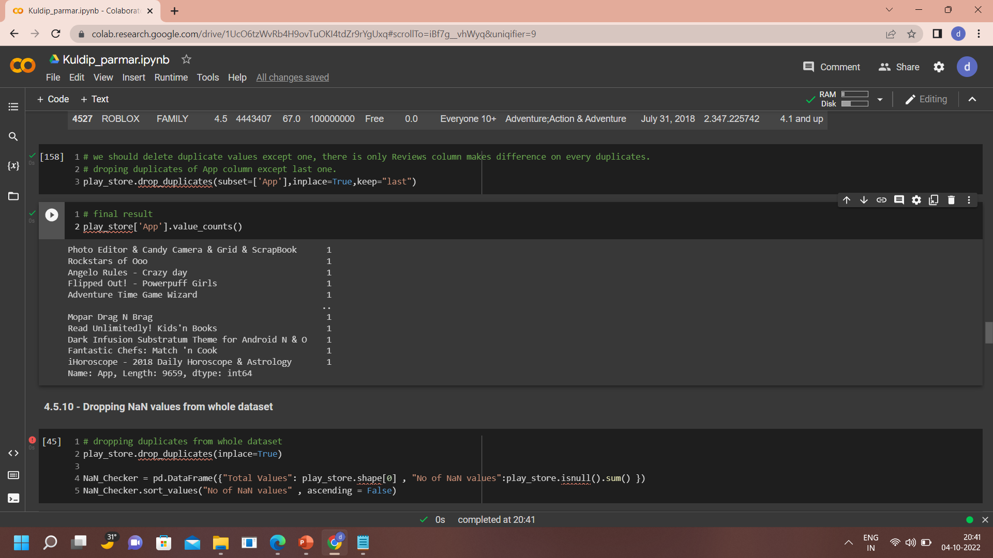
Android_Ver Column Cleaning
Before Cleaning
App Column Cleaning
Duplicates removed
Before Cleaning

Slide 17
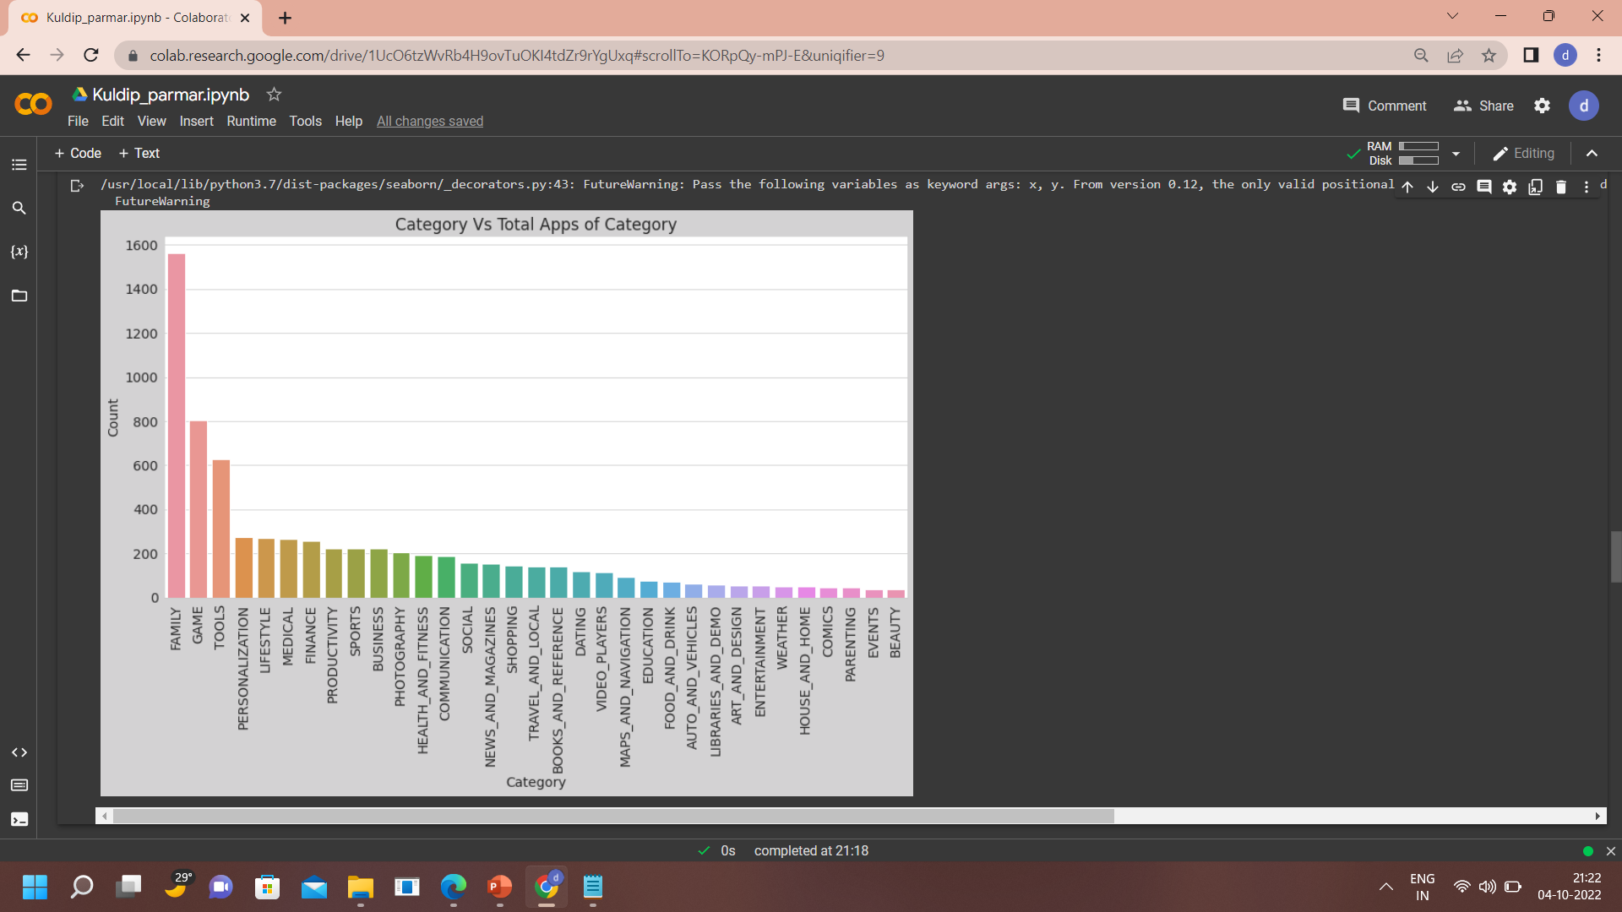
Data Visualization
Which Category contains how many Apps

Slide 18
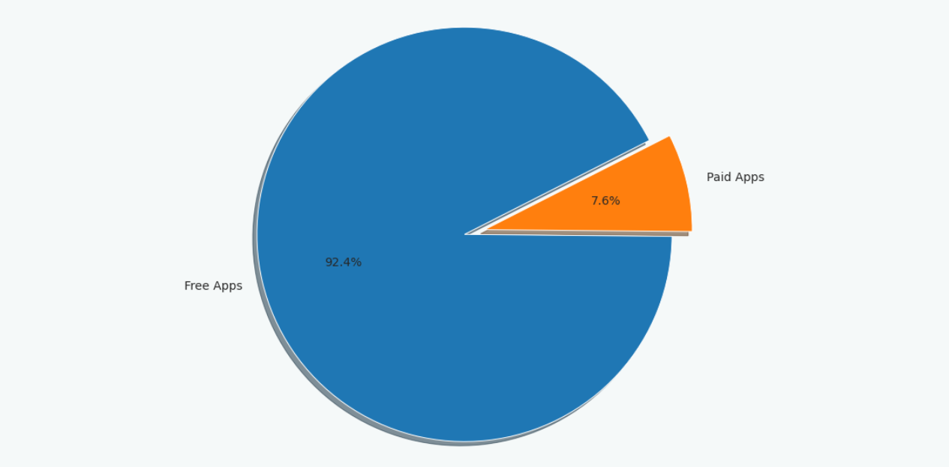
Free App and Paid App in percentage

Slide 19
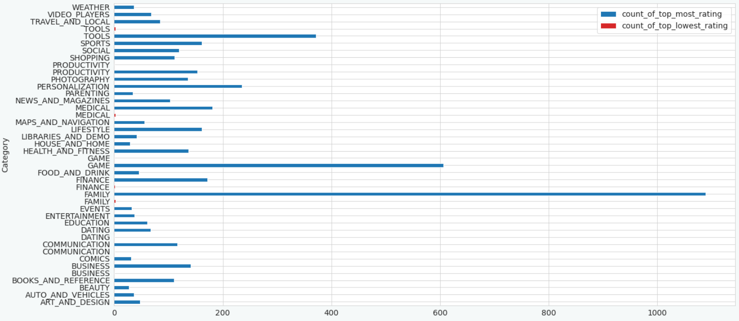
Rating over 4 (Blue) & Rating equals 1(Red)

Slide 20
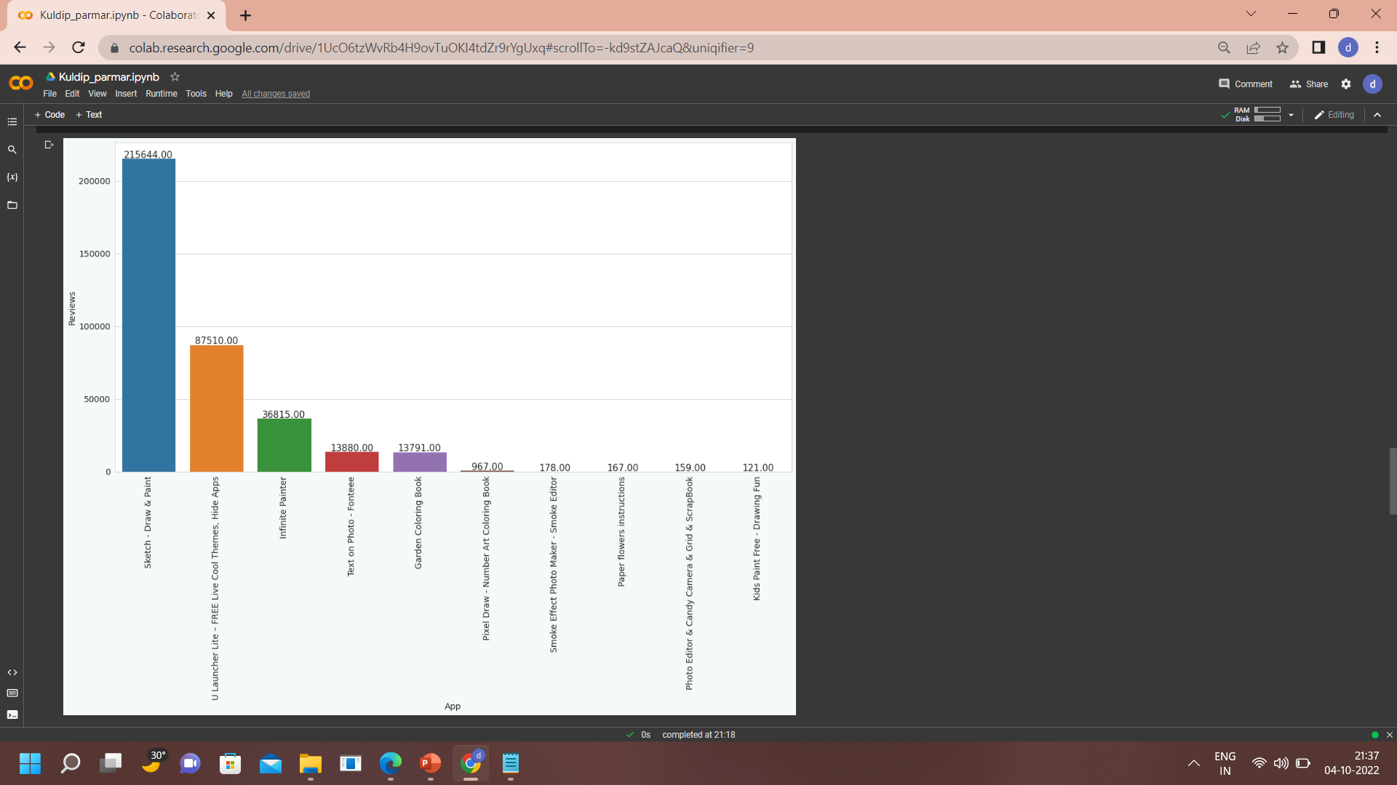
Top Most Reviewed Apps
Top Most Reviewed Apps

Slide 21
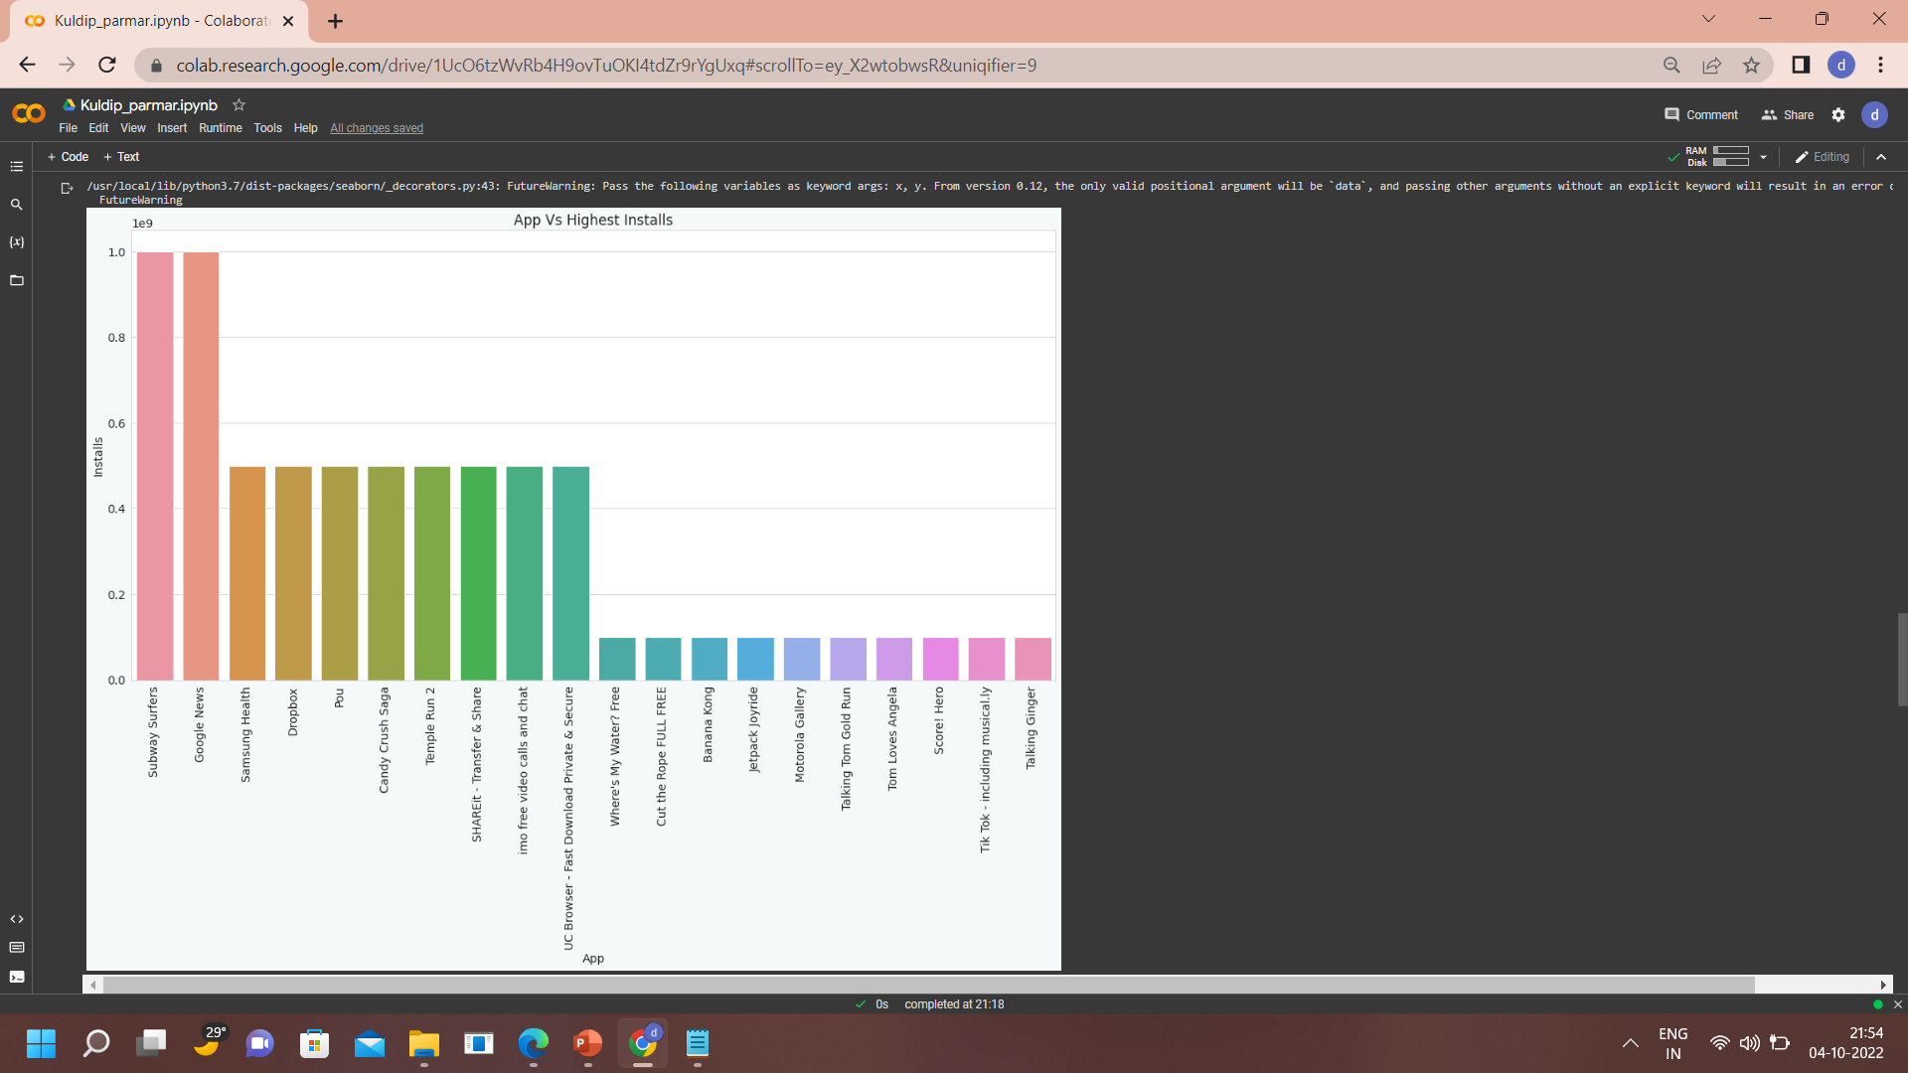
Most Downloaded App

Slide 22
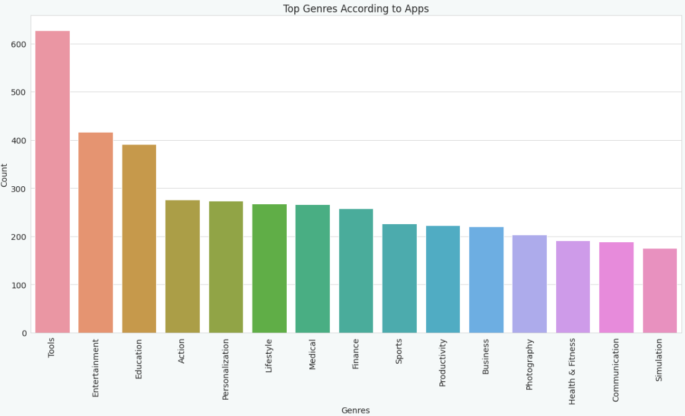
Top Genres based on Apps

Slide 23
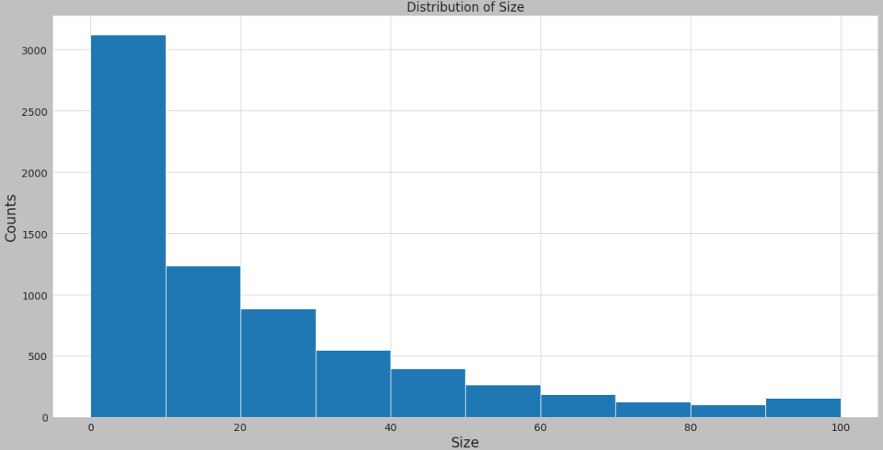
Size of Application over Number of App

Slide 24
User Reviews Dataset
Column Overviews :
Sentiment basically determines the attitude or the emotion of the user. e.g. (whether it is positive or negative or neutral).
Sentiment Polarity is float which lies in the range of [-1,1]
" 1 -> Positive Statement
" -1 -> Negative Statement
Sentiment Subjectivity generally refer to personal opinion, emotion or judgment, which lies in the range of [0,1].
Translated_Review is short explanation of feedback on App by user after using App.

Slide 25
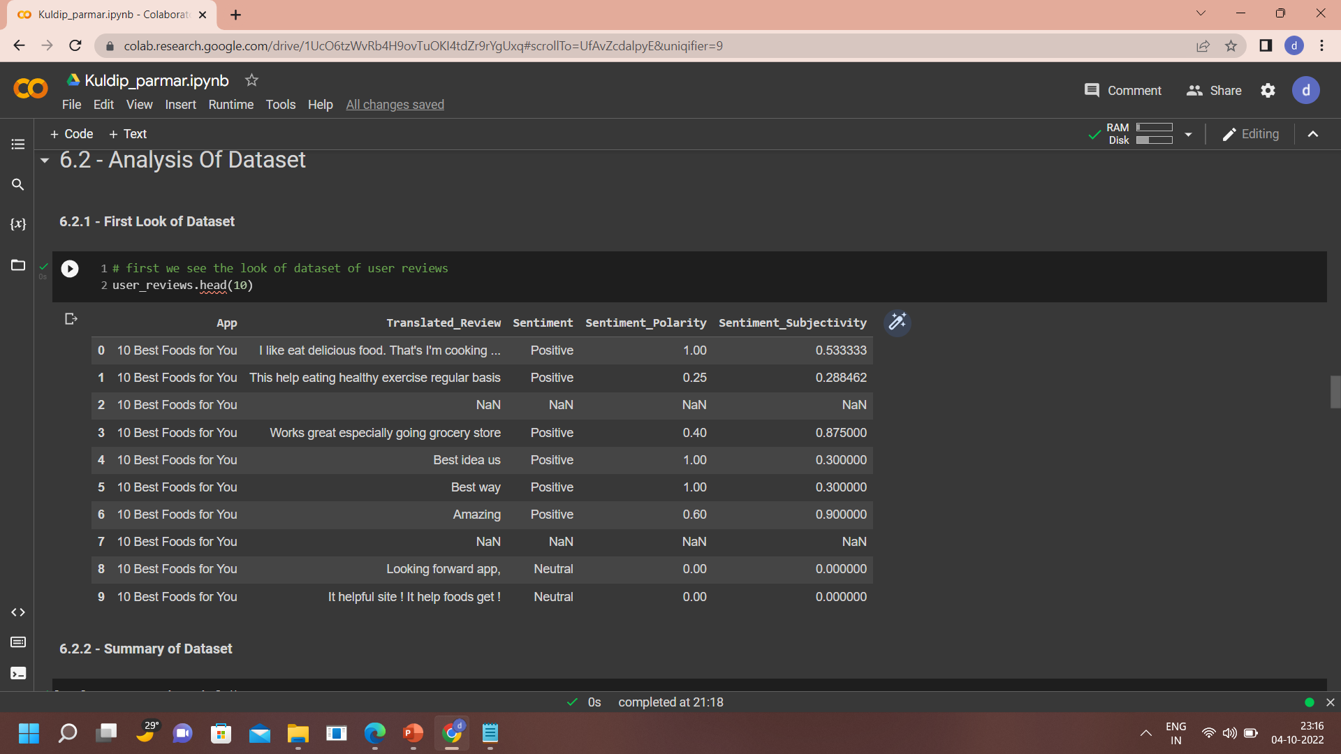
Data Exploration
First Look of Data
All the column is categorical so we have to convert Sentiment_Polarity , Sentiment_Subjectivity to Numeric type.
Also we have to remove Nan value.

Slide 26
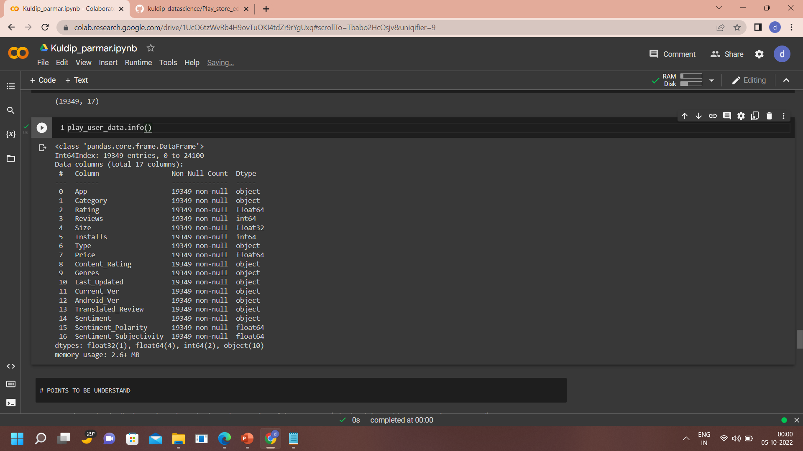
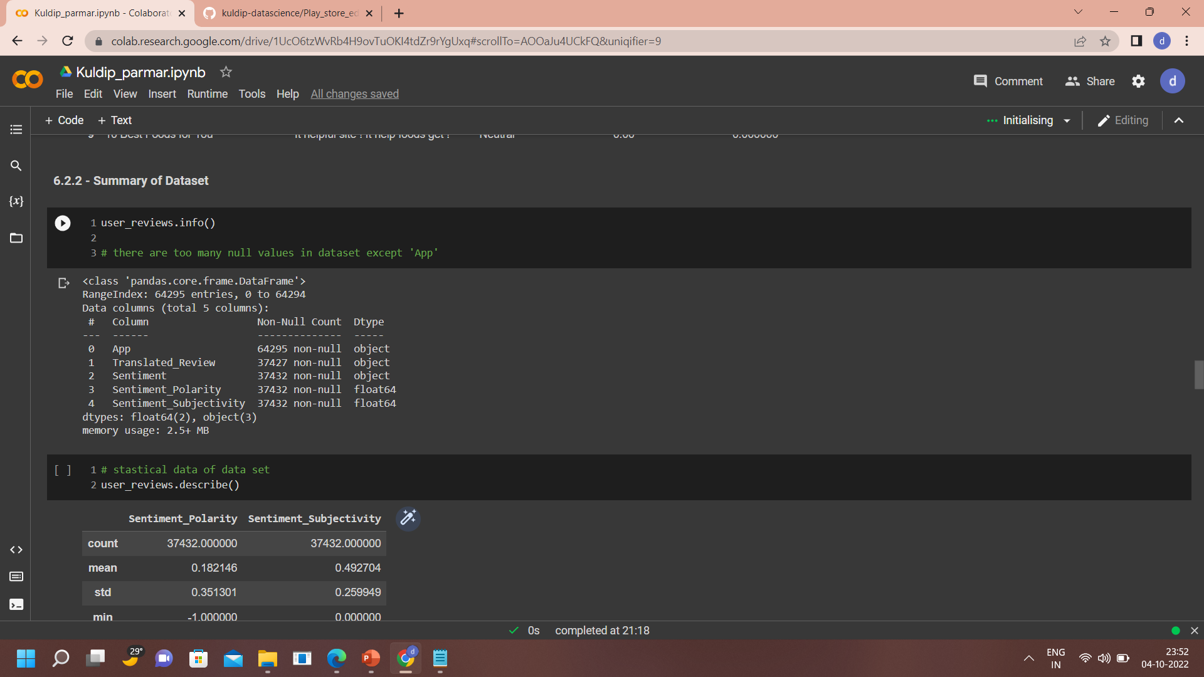
Nan Value Removed
Shape (19349 , 17)
Shape (64295 , 5)
Before Cleaning
After Cleaning

Slide 27
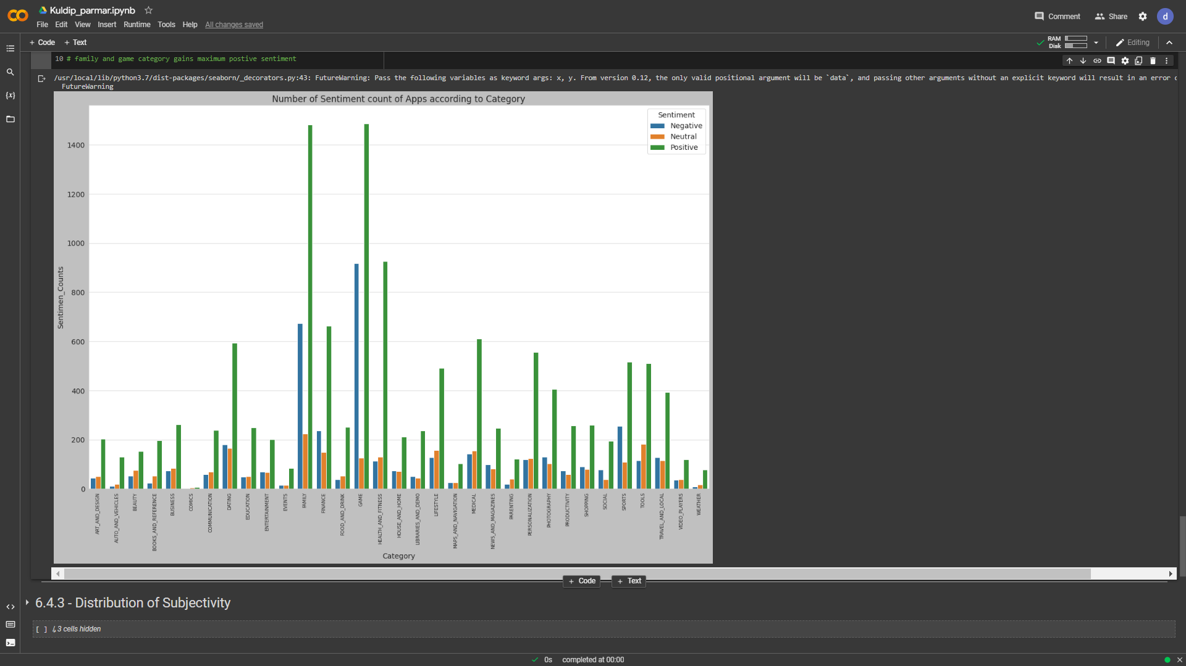
Number of Sentiments Counts of App according to Category

Slide 28
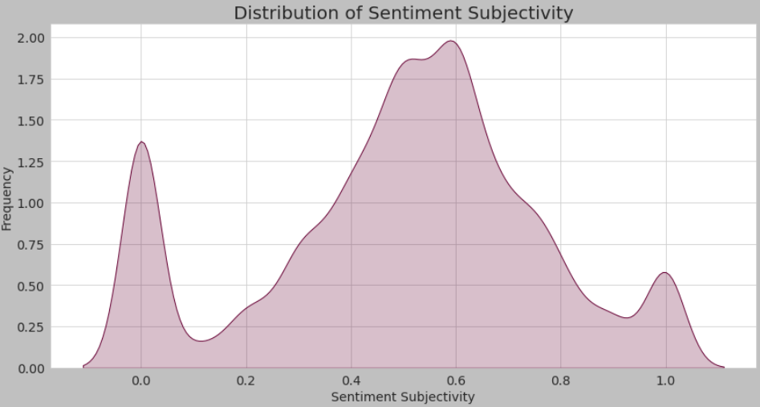
Distribution of Sentiment Subjectivity

Slide 29
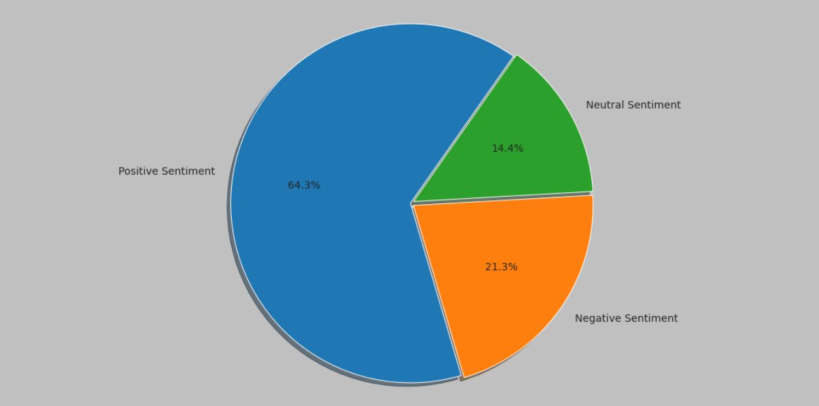
Percentage of Different Sentiments

Slide 30
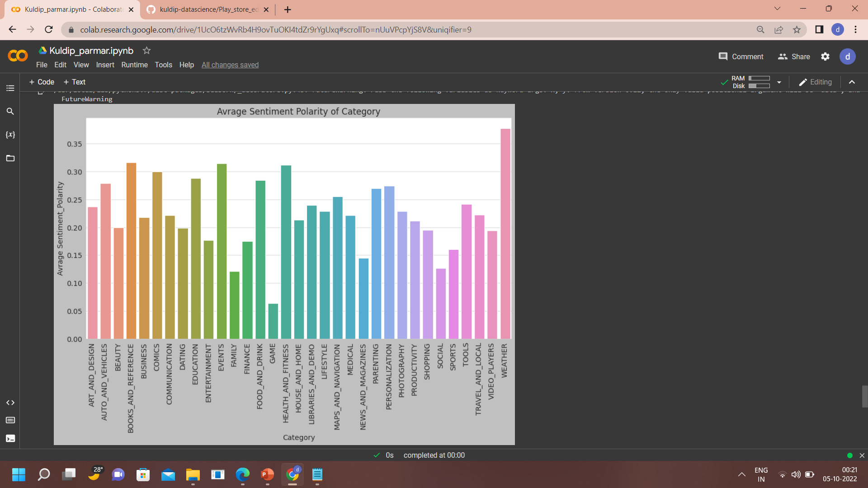
Average Sentiment Polarity of Category

Slide 31
Conclusion
Maximum Apps Belongs From Family and Game Category.
Play Store Contains 92.6% Free Apps and 7.4% Paid Apps.
( Family , Game , Tools ) Category's App Got Maximum Rating where ( Dating , Productivity , Business ) Category's App Got Lower Rating( Equals 1).
Following Apps Got Maximum Reviews.
Sketch - Draw & Paints.
U Launcher Lite- Free Live Cool Themes,Hide Apps.
Infinite Painter.
Subway Surferes , Google News , Samsung Health is Top Most Downloaded Apps on Play Store.
There are 3000+ Applications has Size between 0-10 MB, so User Prefers Small Size Apps Compared to Large one.
Installs & Reviews are highly positive correlated. The reason those application got Highest no of Installs they also got Highest no of Review.
Family and Game Category gains Maximum Postive Sentiment.
Most Apps emotion,personal opinion, judgment lays Between 0.4 to 0.7
App Feedback(Sentiment) Given by User As Follow.
64.3% - Positive Sentiment
21.3% - Negative Sentiment
14.4% - Neutral Sentiment

Slide 32
